Slide 1
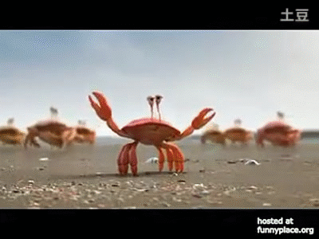
1. Facing challenges is not difficult
The way senior Management and the Leads handled the trainings and the guidance provided helped Interns and new Joiners to fit in the Challenging environment
2. As a Team we grow strong, stronger , Strongest together
The Collaboration, team has portrayed is tremendous which made huge Issue count look smaller and proved working together is always a success
3. Stay Calm and Have Fun
Through Weekly contests, Got to know the team mates better which led to stronger bonding and better understanding. Got the chance to get our creative juices flowing. A refreshing, relaxing escape from all the covid-19 tension that’s going around us.

Slide 2
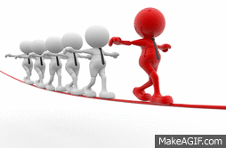
4. Flexibility and Cross Skilling
Most of us are not from SAP/Ariba background, we had an opportunity to learn quickly in GP which made us Flexible; Ready to adapt and accept the changes come in our way in future.
5. Leadership is Strength and responsibility
We have witnessed this in GP. Max, Chiranjeevi and other seniors were very cool and were always available to help us irrespective of their busy schedules which helped us to learn a lot and inspired us to be available to internal team member’s all the time and led to greater outcomes.

